Slide 1
KS2 SATS 2019

Slide 2
How are we preparing?
*Practising previous SATS papers *Continuous Assessment *Booster Classes & homework club *Focused Maths Lessons *Focused Spelling Lessons *Focused SPaG Lessons *Guided and Independent Reading *Home Learning – TTRS CGP Booklets *Target Setting and Mentoring

Slide 3
How are we preparing?
*Booster Classes & homework club
-Letters sent out on Wednesday
-Every Thursday 3:20 – 4:15
-Starts Thursday 7th Feb
*Focused SPaG
-Work to be complete on SPAG.com at home.
*Test Base
-Previous SATs questions. *Home Learning – TTRS CGP Booklets
-Letter with prices to be sent out shortly

Slide 4
WHEN ARE THE TESTS?
Date | Exam
Monday 13 May 2019 | Spelling, Punctuation & Grammar - Paper 1 Spelling, Punctuation & Grammar - Paper 2
Tuesday 14 May 2019 | English Reading
Wednesday 15 May 2019 | Maths Paper 1 (Arithmetic) Maths Paper 2 (Reasoning)
Thursday 16 May 2019 | Maths Paper 3 (Reasoning)

Slide 5
https://michaelt1979.wordpress.com/2016/01/23/ks-tests-a-video-for-parents/

Slide 6
REPORTING RESULTS 1
Children’s achievement will be measured and reported on in school performance tables.
Teacher assessments will be passed on to secondary schools, however we also have in depth transition meetings and overall teacher assessments are shared.
The papers are returned in early July.
Written reports are given at the end of the summer term along with your child’s results.

Slide 7
REPORTING RESULTS 2
From 2016, KS2 national curriculum test outcomes were no longer reported using levels. Scaled scores are used instead.
Instead of receiving levels as happened in previous years, each pupil sitting the tests will receive:
A raw score – the total number of marks scored in the test
A scaled score – based on the raw score converted after the test.
100 = threshold/met the standard expected
Confirmation of whether or not they have attained the national standard

Slide 8
HELPING AT HOME
Try not to put pressure on your child.
Support with homework and targets that have been discussed at Parents’ Evening.
Read regularly and discuss a variety of texts – not just ‘listening’ to your child read.
Short bursts of mental maths, times tables and problem solving etc.
Use the previous test papers only if advised by teachers, as they are used in school as assessment and practise for the children. Using the same papers at home makes it difficult for us to prepare the children adequately.

Slide 9
WE RECOMMEND:-
Early nights and lots of sleep
Good attendance
Good punctuality
A good breakfast
LOTS OF PRAISE AND ENCOURAGEMENT!

Slide 10
USEFUL WEBSITES
http://www.bbc.co.uk/education/highlights/sections/primary
This is an excellent site, recently updated to provide revision help for KS2, KS3, KS 4 and KS5. This covers all subjects through activities and tests.
http://www.icteachers.co.uk/children/children_sats.htm
A wide range of KS2 SATs questions, from both past papers and their own team of teachers.
http://primaryhomeworkhelp.co.uk/
Revision pages from the former site of Woodlands Junior School. These revision pages were put together by staff at Woodlands Junior School. The site provides links to many useful games to help with revision.
http://www.compare4kids.co.uk/maths.php
This links to lots of other websites which have games and activities on specific subjects
http://www.emaths.co.uk/index.php/4-students/past-papers/ks2-sat-papers
Over 10 years of past SAT papers for you to use
(Please do not use papers after 2007 as these will be used in school during revision lessons)
http://www.parkfieldict.co.uk/sats/
English and Maths revision activities and games.

Slide 11
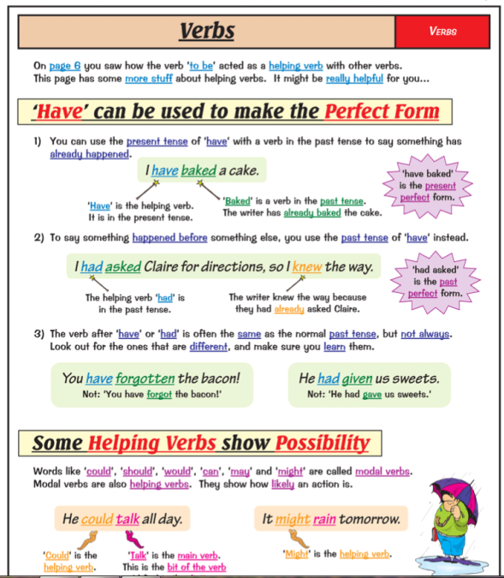
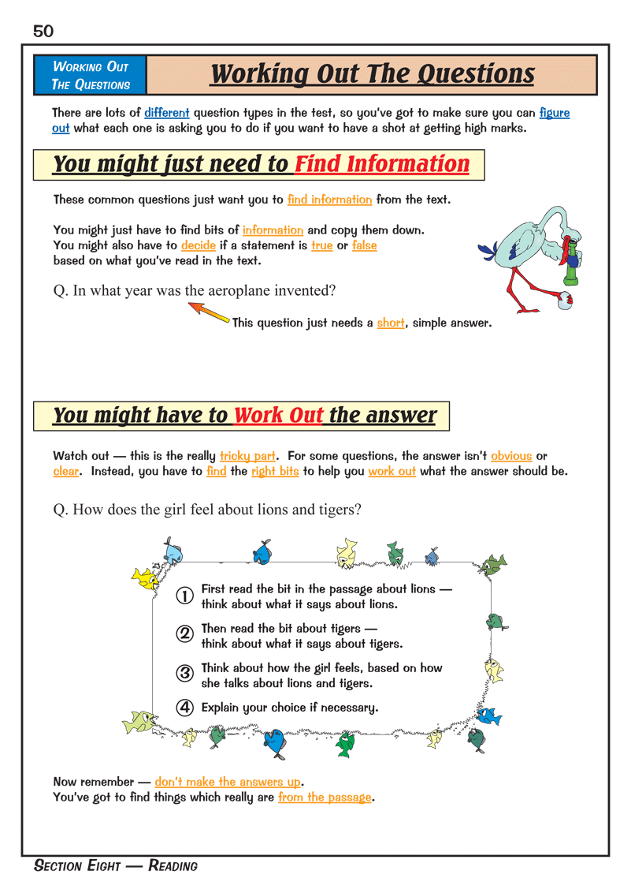
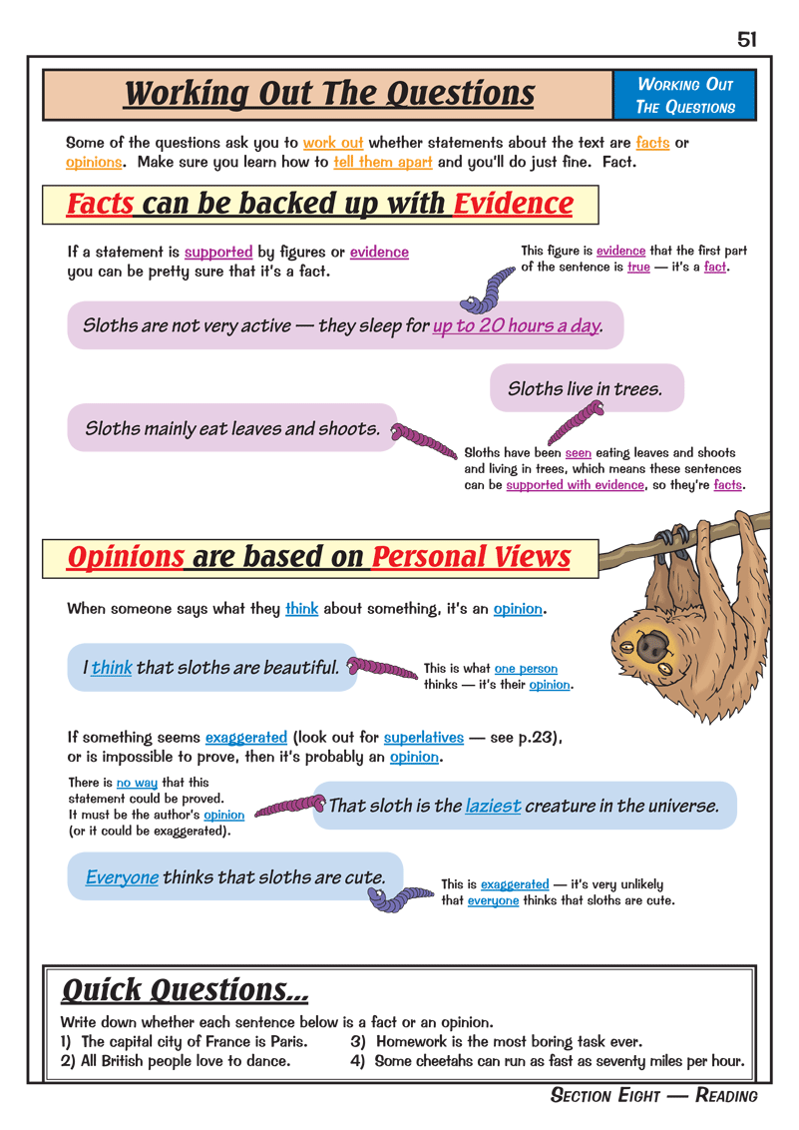
E English Revision Book

Slide 12
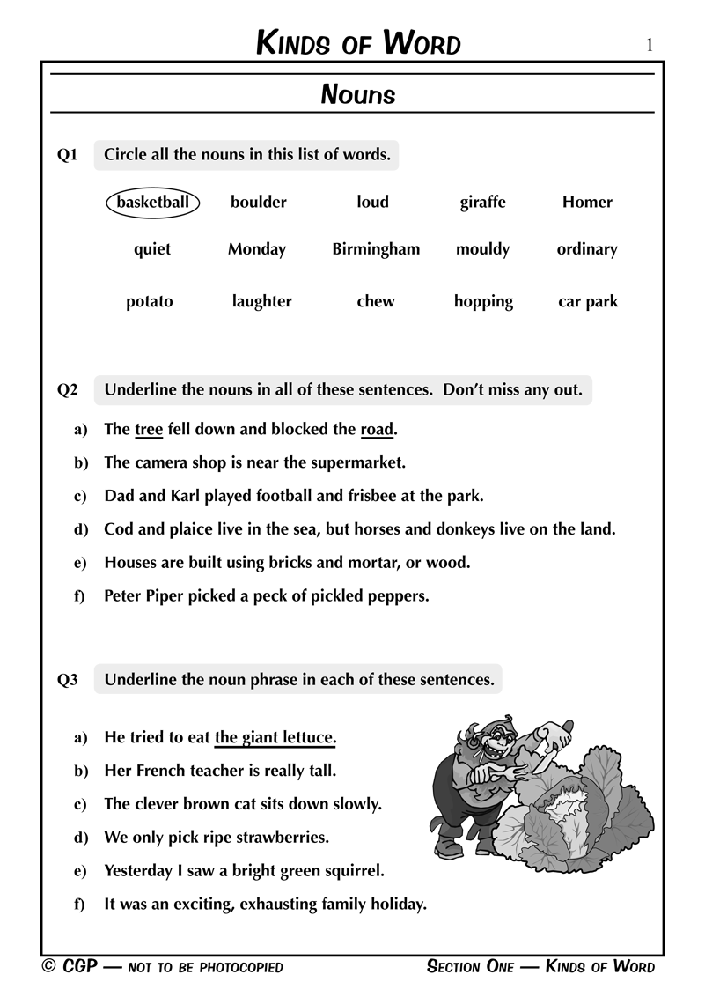
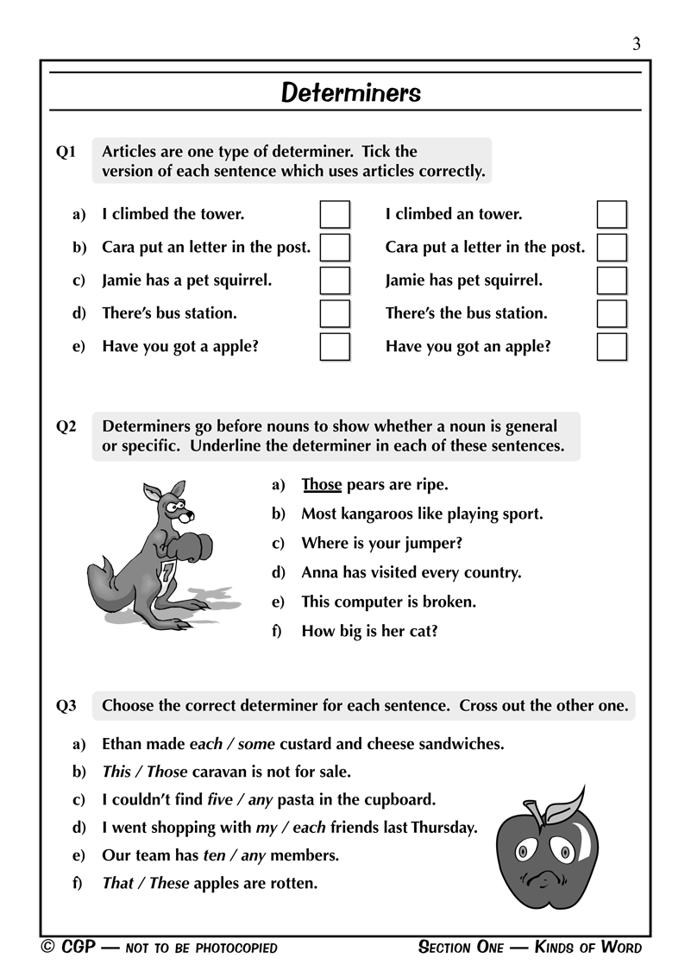
English Question Book

Slide 13
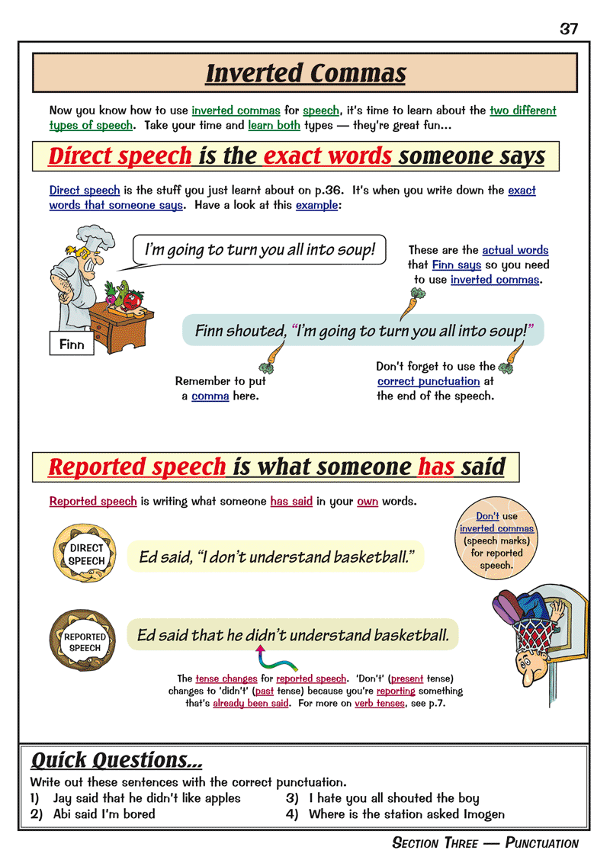
Grammar, Punctuation & Spelling Book

Slide 14
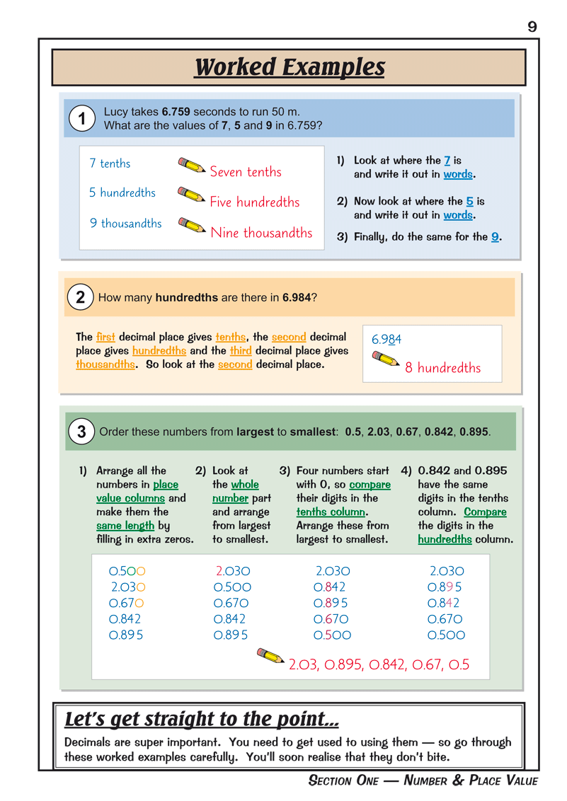
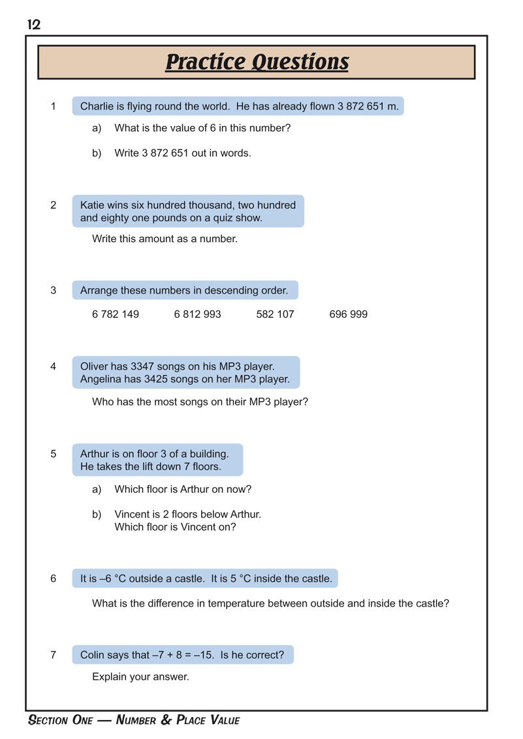
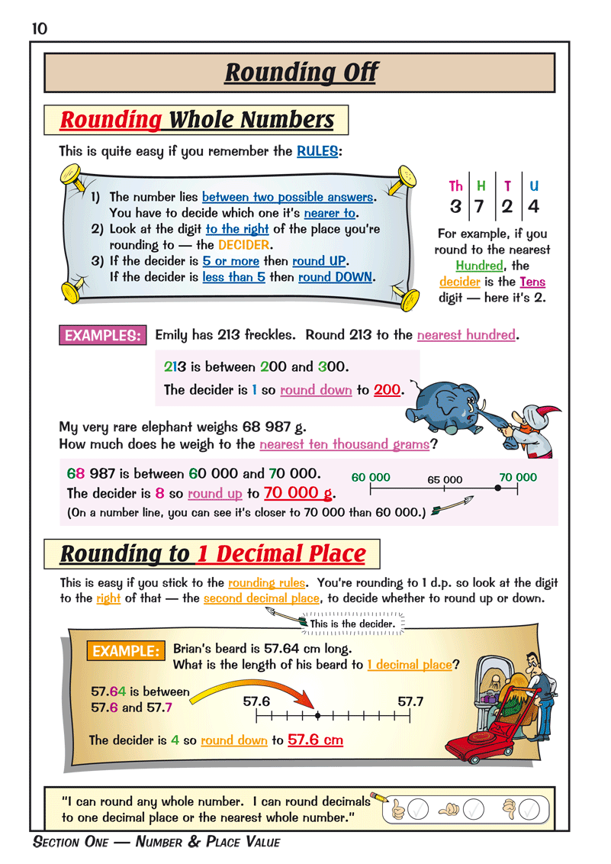
Maths Revision Books

Slide 15
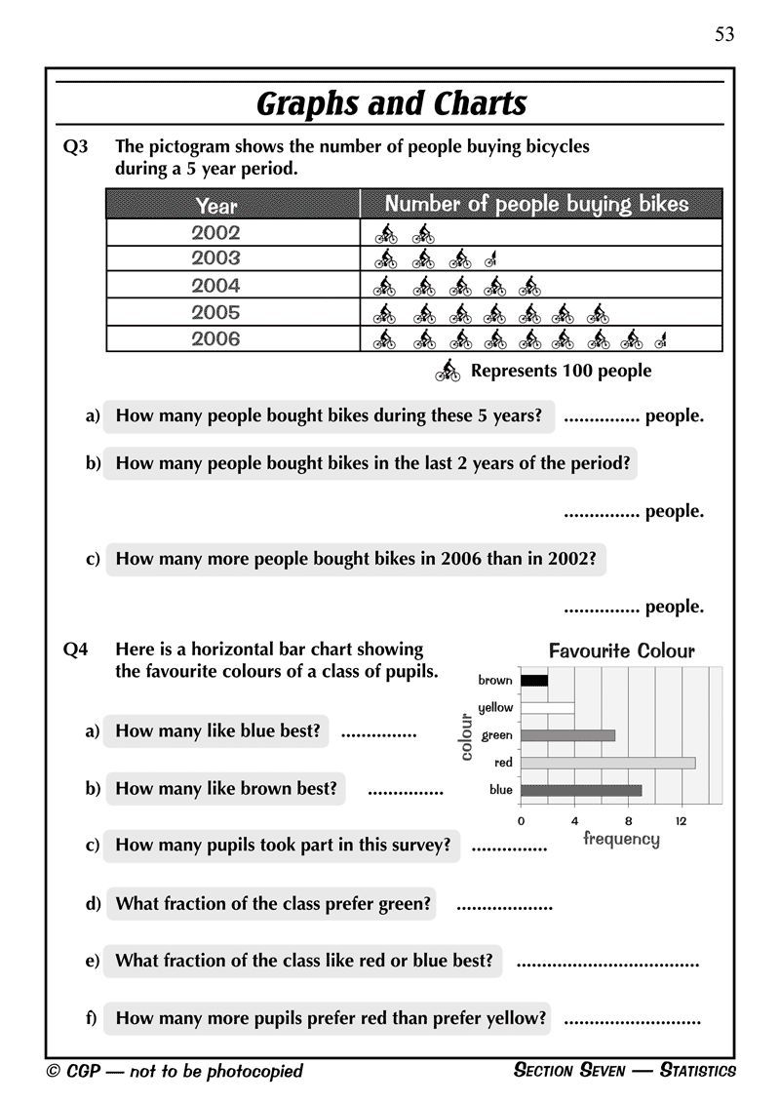
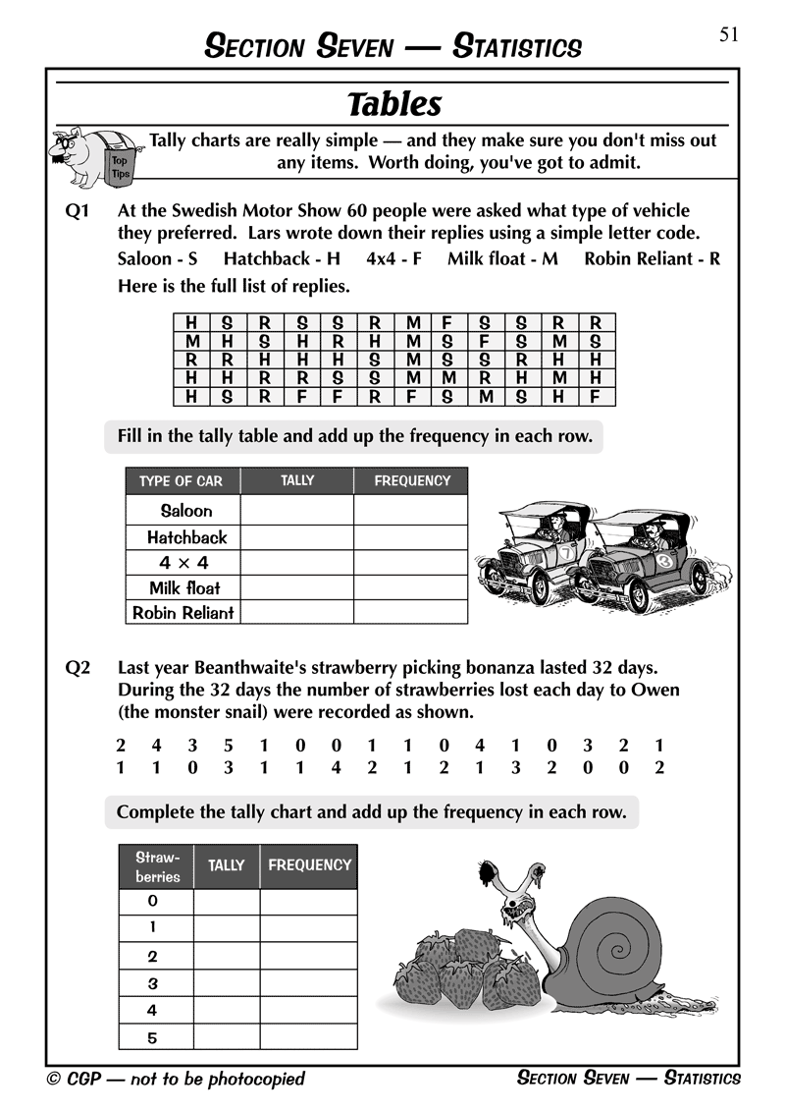
Maths Question Books

Slide 16
ANY QUESTIONS?
?

